Slide 1
SQL Server 2000 Internals
Locking – Part II
Ramkumar Murugesan

Slide 2
Locking - Part II
Locking Architecture
Memory Allocation for Locks
Dissecting Syslockinfo table
Resolving Blocks
Deadlocks
Binding Connections

Slide 3
Next Section>>>
Locking Architecture
Topics…
Locking Architecture | Hash Table | Lock Block | Lock Owner Block | Summary

Slide 4
Locking Architecture
Locks are internal memory structures - they consume part of the memory used for SQL Server
Locks are not stored in disks
Each locked data resource (a row, index key, page, or table) requires 64 bytes of memory to keep track of the…
  Database,
  Type of lock
  Information describing the locked resource
The lock block contains pointers to lists of lock owner blocks
Each process holding a lock must have a lock owner block of 32 bytes

Slide 5
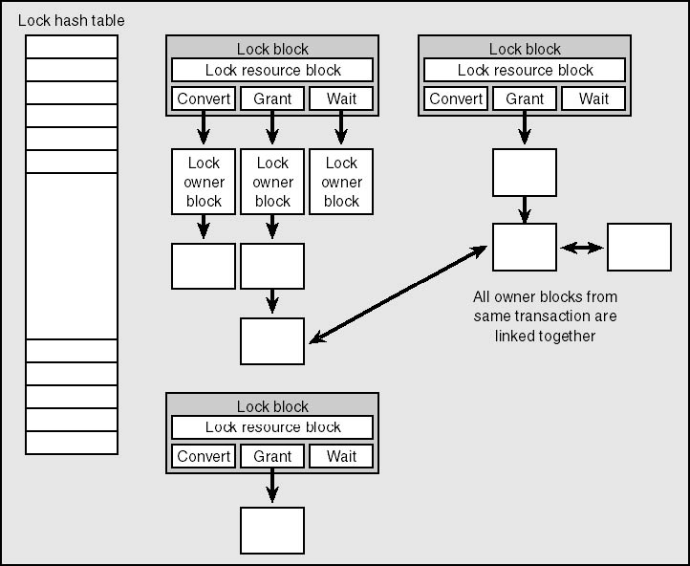
Locking Architecture
Figure: SQL Server’s locking architecture

Slide 6
Hash Table
The lock manager maintains a lock hash table
Lock resources, contained within a lock block, are hashed to determine a target hash slot in the hash table
All lock blocks that hash to the same slot are chained together from one entry in the hash table
Each lock block contains a 16-byte field that describes the locked resource and a pointer to lists of lock owner blocks
This 16-byte description is viewable in the syslockinfo table in the rsc_bin column

Slide 7
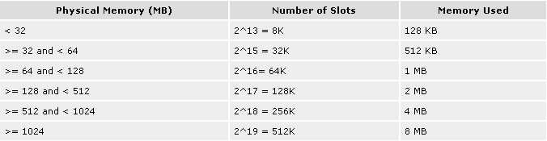
Hash Table
The number of slots in the hash table is based on the system's physical memory
All instances of SQL Server on the same machine will have a hash table with the same number of slots
Each entry in the lock hash table is 16 bytes in size and consists of a pointer to a list of lock blocks and a spinlock to guarantee non-concurrent access to the same slot
Figure Above: Number of slots in internal hash table

Slide 8
Lock Block
The lock block is the key structure in SQL Server's locking architecture
A lock block contains the following information:
  Lock resource name
  Pointers to the lock hash table
  General summary information
  Pointer to a list of lock owner blocks for locks on this resource that are waiting to be converted to another lock mode (convert list)
  Pointer to a list of lock owner blocks for locks on this resource that have been granted (granted list)
  Pointer to a list of lock owner blocks for locks that have been requested on this resource but have not yet been granted (wait list)

Slide 9
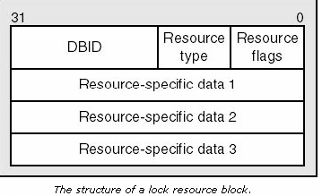
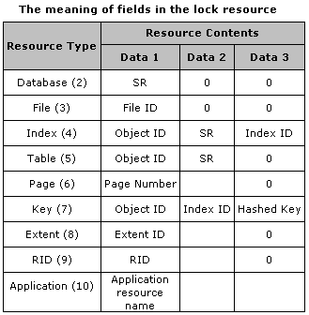
Lock Block
For a Key resource, Data2 is 2 bytes and Data3 is 6 bytes
For an application resource name resource, the first 4 bytes of the name are used; the remaining bytes are hashed

Slide 10
Lock Block
Following are some of the possible SR (Sub-Resource) values
  If the lock is on a DB resource, SR indicates…
    Either Full database lock or Bulk operation lock
  If the lock is on a Table resource, SR indicates…
    Full table lock (default) or Update statistics lock or Compile lock
  If the lock is on an Index resource, SR indicates…
    Full index lock (default) or Index ID lock or Index name lock

Slide 11
Lock Owner Block
A lock owner block represents a process that has been
  Granted a lock, or
  Is waiting for the lock, or
  Is in the process of converting to the lock
Each lock owned or waited for by a session is represented in a lock owner block
Lists of lock owner blocks form the grant, convert, and wait lists that hang off of the lock blocks
Each lock owner block for a granted lock is linked with all other lock owner blocks for the same transaction or session so that they can be freed as appropriate when the transaction or session ends

Slide 12
Next Section>>>
Memory Allocation for Locks

Slide 13
Memory Allocation for Locks
The lock manager pre-allocates the number of lock blocks and lock owner blocks at server startup
If the number of locks is fixed by sp_configure, it allocates that configured number of lock blocks and the same number of lock owner blocks
If the number is not fixed (0 means auto-tune), it allocates 500 lock blocks on a SQL Server 2000, Desktop Edition server and 2500 lock blocks for the other editions and allocates twice as many (2 * # lock blocks) of the lock owner blocks
At their maximum, the static allocations can't consume more than 25 percent of the committed buffer pool size

Slide 14
Next Section>>>
Dissecting syslockinfo table

Slide 15
Dissecting syslockinfo table
Syslockinfo table holds all the locks that are held for an instance of a SQL Server
syslockinfo table exists in master
When a lock is requested, Lock manager checks the syslockinfo table to find whether the resource is locked
Columns prefixed by rsc_ are taken from a lock resource block
Columns prefixed by req_ are taken from a lock owner block
The rsc_bin field represents the resource block

Slide 16
Dissecting syslockinfo table
After byte swapping, we get…
  Byte 0: Flag: 0x00
  Bytes 1: Resource Type: 0x07, a Key resource
  Bytes 2 through 3: DBID: 0x0005
  Bytes 4 through 7: ObjectID: 0x4E53A1AA (1314103722 decimal)
  Bytes 8 through 9: IndexID: 0x0001 (the clustered index)
  Bytes 10 through 16: Hash Key Name: 0x080000000000

Slide 17
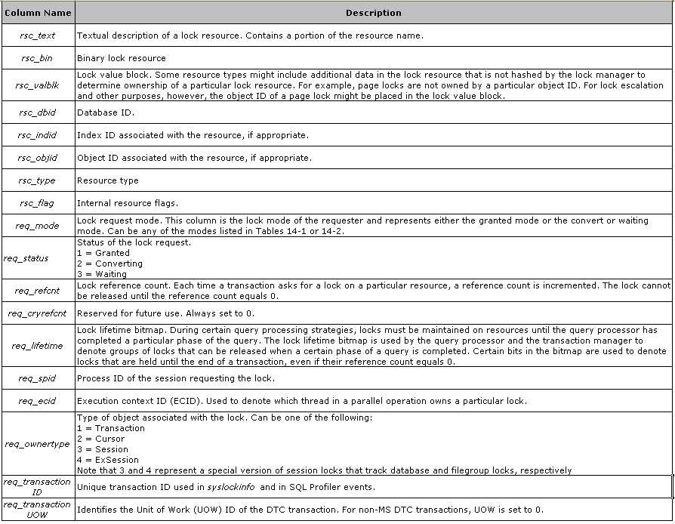
syslockinfo table

Slide 18
Next Section>>>
Resolving Blocks
Topics…
Best Practices | Exercises

Slide 19
Resolving Blocks - Best Practices
Use Transactions when two or more DML statements are involved
Keep all unrelated statements outside the scope of the transaction
Keep transactions as Short as possible
Avoid outside process invocation in between the transaction
Use custom Error handlers to catch the errors raised
Use Lock hints only when required
The Transaction LOCK_TIMEOUT period should be set if you think there is a possibility of transactions running long
Use clustered indexes on heavily used tables
Ensure that the UPDATE and DELETE statements use an index

Slide 20
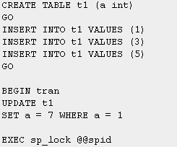
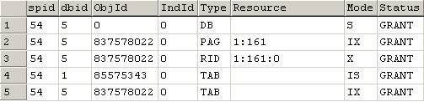
Resolving Blocks - Exercise
In the first connection, to find the row to update, SQL Server must first do a search and acquire UPDATE locks on the table.
Since SQL Server does not have a useful index to help find the desired row, it uses a table scan.
This means every row in the table acquires an update lock, and the row actually being updated acquires an exclusive lock, which is not released until the end of the transaction
As a result, an UPDATE statement on t1 in the second connection will be blocked

Slide 21
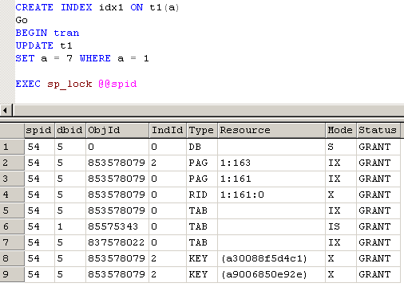
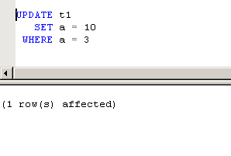
Resolving Blocks - Exercise
After creating an non-clustered index on the table, try doing the same exercise
The update statement in the second connection runs fine with out blocking

Slide 22
Next Section>>>
Deadlocks
Topics…
Cyclic Deadlock | Conversation Deadlock | Automatic Deadlock Detection and Removal

Slide 23
Deadlocks
A deadlock occurs when two processes are waiting for a resource and neither process can advance because the other process prevents it from getting the resource
In SQL Server, two main types of deadlock occur…
  Cycle Deadlock occurs when a process A holds a resource needed by process B and Process B holds a resource needed by Process A
  Conversation Deadlock occurs when Process A and process B each hold a shared lock on the same page within a transaction and each process wants to promote its shared lock to an exclusive lock but cannot do so because of the other process's lock
Apart from tables, processes can wait for memory, threads and communication buffers and end in deadlock

Slide 24
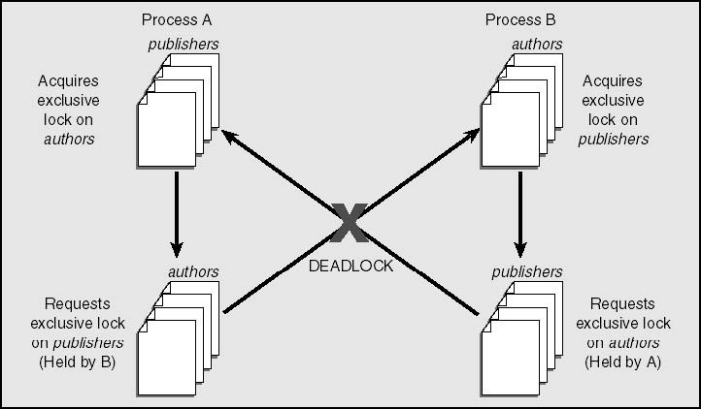
Deadlocks – Cycle Deadlock
Figure: A cycle deadlock resulting from each of two processes holding a resource needed by the other

Slide 25
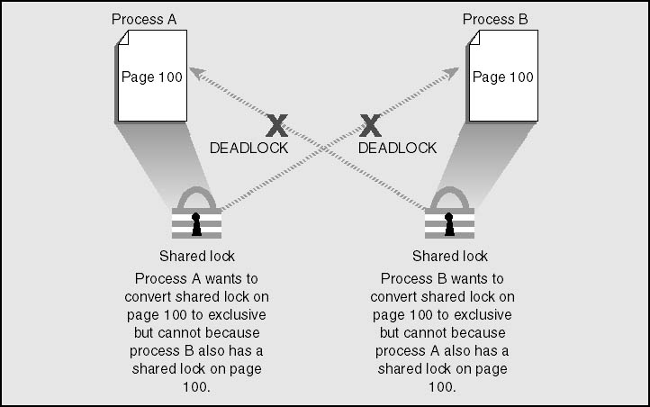
Deadlocks – Conversation Deadlock
A conversion deadlock resulting from two processes wanting to promote their locks on the same resource within a transaction

Slide 26
Automatic Deadlock Detection and Removal
SQL Server automatically detects deadlocks and intervenes through the lock manager, which provides deadlock detection for regular locks
LOCK_MONITOR a separate thread in SQL Server, checks the system for deadlocks every 5 seconds
This LOCK_MONITOR thread checks for deadlocks by inspecting the list of waiting locks for any cycles
SQL Server attempts to choose as the victim the process that would be the least expensive to roll back, considering the amount of work the process has already done
SET DEADLOCK_PRIORITY LOW | NORMAL statement can process to sacrifice itself as the victim if a deadlock is detected

Slide 27
Next Section>>>
Binding Connections
Topics…
Binding Connections | Examples

Slide 28
Binding connections
Two or more different connections sharing a lock space and transaction space
The first connection asks SQL Server to give out its bind token The bind token is passed by the application for use in subsequent connections
The bind token acts as a "magic cookie" so that other connections can share the lock space of the original connection
Locks held by bound connections do not lock each other
The sp_getbindtoken and sp_bindsession system stored procedures get and use the bind token
Usage: Extended Stored Procedures, Process Monitoring or to rollback or commit a long running process
T-SQL Statements must be inside a transaction in order to get a bind token

Slide 29
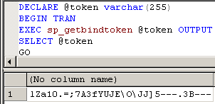
Binding Connections - Example
In the first query window, execute the batch
Get the Token number and pass it to the binding SP and execute it in a different window (connection)

Slide 30

Binding Connections - Example
In the first query window execute a command that locks some data, inside the transaction that already begun
In the second Query Window, execute SELECT command for selecting the locked records
Executing ROLLBACK command in the second window would rollback the transaction in the first query window

Slide 31
End of Topic – Locking Part II
?

Slide 32
End of Topic – Locking Part II
Thank you
Next Topic
Architecture Components | Storage Concepts | Transaction Logs | Indexes I | Indexes II | Locking I | Locking II | Query Processor

